Slide 1
Mental and Behavioral Health Disorders
Monica Bellucci, M.Ed, LMHC
Cindy Boyle, South Hadley Police Department

Slide 2
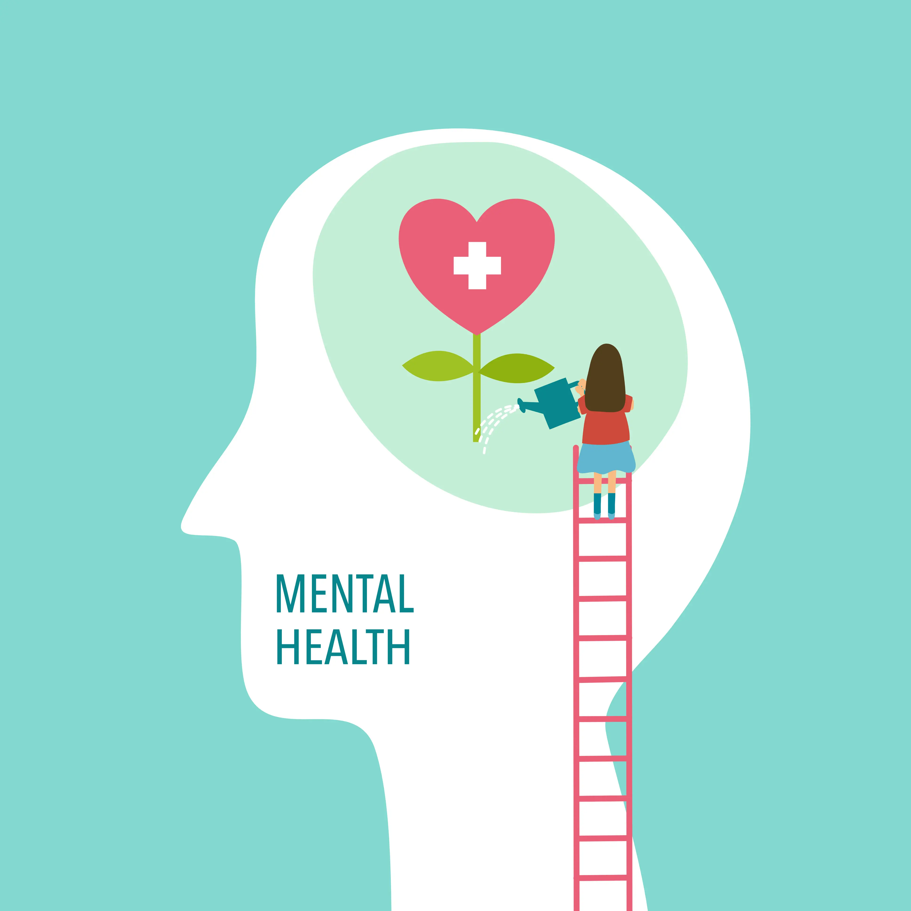
Learning objectives
Participants will gain better understanding of mental health disorders
Participants will gain better understanding on why someone with mental health may contact the police
Participants will gain better understanding of youth mental health

Slide 3
Mental health overview
Approximately 1 in 5 adults in the U.S. (43.8 million, or 18.5%) experiences mental illness in a given year.
Approximately 1 in 16 adults have a Serious Mental Illness
90% of those who die by suicide have an underlying mental illness.
Mental Illness results in more disability than:
Cancer
Diabetes
Heart Disease

Slide 4
What is a mental illness
Substantial disorder of
Thought
Mood
Perception
Memory
Can significantly impair judgment, behavior, capacity to recognize reality, or ability to meet the ordinary demands of life

Slide 5
What is considered a serious mental illness
A serious mental illness is defined as mental, behavioral or emotional disorder resulting is serious functional impairment, that substantially interfere with or limits one or more major life areas.
Inability or major challenges with:
Holding down a job
Maintaining relationships
School
Housing

Slide 6
What are types of mental illness
Mood Disorders
Depressive Disorders, Bipolar Disorder
Anxiety Disorders
Psychotic Disorders
Schizophrenia, (at times) Major Depression, Bipolar
Personality Disorders
Borderline Personality Disorder, Antisocial Personality Disorder
Substance Use Disorders
Stress & Trauma-Related Disorders
PTSD
Dissociative Disorders

Slide 7
What causes mental health

Slide 8
Barriers to mental health treatment
Nearly 60% of adults with a MI do not receive treatment
Nearly 50% of youth (8yrs to 15 yrs.) do not receive treatment
Poverty/access to insurance
Long wait list
Single most common barrier is SHAME AND STIGMA

Slide 9
Anxiety disorders
Occasional anxiety and worry are a normal part of life.
Anxiety disorders involve more than temporary worry or fear.
The anxiety does not go away, can get worse over time, and can interfere with daily activities.
Most anxiety disorders begin in childhood, adolescence and early adulthood.

Slide 10
Types of anxiety disorders
Panic Disorder (most common 911 call)
Obsessive Compulsive Disorder *
Post Traumatic Stress Disorder
Social Anxiety Disorder
Specific Phobias
Generalized Anxiety Disorder

Slide 11
Symptoms of anxiety disorders
Feelings of panic, fear and uneasiness
Uncontrollable, obsessive thoughts
Repeated thoughts or flashbacks of traumatic experiences
Nightmares
Ritualistic behaviors, such as repeated hand washing
Problems sleeping
Cold or sweaty hands
Shortness of breath
Palpitations
An inability to be still and calm
Dry mouth
Numbness or tingling in the hands or feet
Nausea
Muscle tension

Slide 12
Physical symptoms of anxiety

Slide 13
Some reasons someone with anxiety may call 911
The psychological symptoms that can come with anxiety
Brainstorm exercise
In your folders
Team up with a person next to you
Fill in where on the body anxiety could manifest

Slide 15
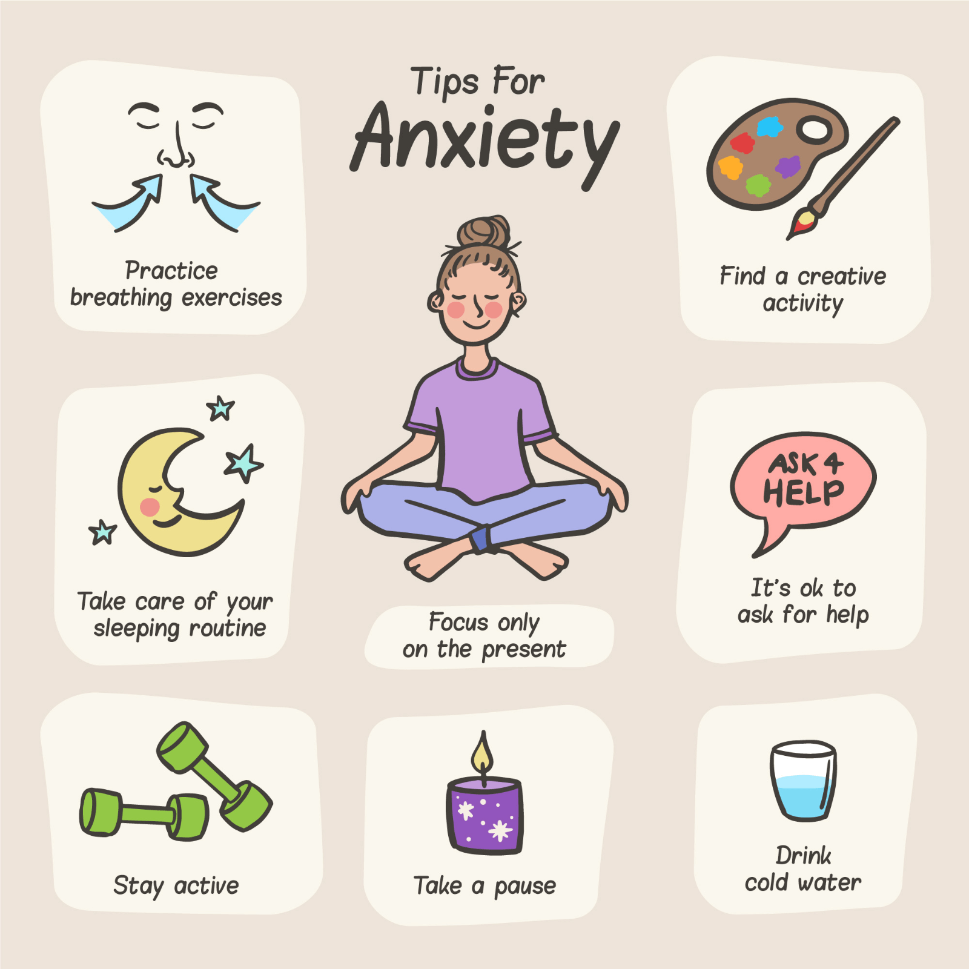
Communication and responding to acute anxiety disorders
Encourage slow ,deep breaths
If this is difficult for the individual, ask him to do it with you
Reassure
Speak slowly & calmly

Slide 16
Depression disorder - its not just “feeling sad”
Extreme sadness, guilt, shame
Decreased memory and concentration, poor academic performance or work performance
Decreased interest/enjoyment in daily activities
Increased irritability, arguments
Change in sleep, appetite, *energy
Physical unease
Social withdrawal
Not relieved by circumstances
Hopelessness, helplessness
Suicidal thoughts

Slide 17
Some reasons individuals with depression may call 911
Suicidal thoughts
Hopelessness
Family, friends, providers may call for wellbeing check

Slide 18
Bipolar Disorder- It’s not just “mood swings”
Also known as manic depression.
A disorder that causes unusual shifts in mood, energy, activity levels, and the ability to carry out day-to-day tasks.
Episodic extremes between states
depressed state and excitable,
euphoric/irritable, impulsive state
Bipolar I diagnosis typically requires an inpatient hospitalization while Bipolar II does not necessarily require this high level of care

Slide 20
Bipolar disorder

Slide 21
Symptoms of mania (“the highs”)
Excessive happiness, hopefulness, and excitement
Sudden changes from being joyful to being irritable, angry, and hostile
Restlessness
Rapid speech and poor concentration
Increased energy and less need for sleep
High sex drive
Tendency to make grand and unattainable plans
Tendency to show poor judgment, such as deciding to quit a job
Drug and alcohol abuse
Increased impulsivity
Can become psychotic (usually delusions of grandeur/religious)

Slide 22
What symptoms may look like
Inability or challenging time interrupting individual, they just keep talking
Individual may display “clanging”, repeating rhyming words, puns or overusing puns with out any logical context meeting, based on sound instead of meaning
Can be overly familiar – may ask for your first name instead of officer _______, asking personal questions, or asking you to be informal and friendly asking personal questions or wanting to give you gifts.
Having delusions of grandeur - they can speak to God, they fell deeply in love with someone extremely recently by making eye contact, they are extremely famous.

Slide 23
Some reasons individuals with bipolar may call 911
Suicidal thoughts/feelings of hopelessness during depression periods
Calls from family members/providers/loved ones for out of character behaviors
Risky behaviors
No/little sleep
Disorganized thought process
Delusions

Slide 24
Hallucinations and delusions
Hallucinations are unusual sensory experiences or perceptions of things that aren't actually present,
Can involve all five senses.
Delusions are false beliefs that are persistent and organized, and that do not go away after receiving logical or accurate information.

Slide 25
Hallucinations and Delusions

Slide 26
Schizophrenia
Schizophrenia is a chronic and severe mental disorder that affects how a person thinks, feels, and behaves.
People with schizophrenia may seem like they have lost touch with reality, often experiencing delusions and hallucinations.
Symptoms lasts longer than six months, often with a decline in work, school and social functioning.
Most common forms of delusions are persecutory -believing others are out to get them/harm them-government, aliens, neighbors
Religious delusions– God is talking to them; they have some mission from God
Delusions of Grandeur –They are an authority figure, they have powers

Slide 27
Symptoms of Schizophrenia
Positive symptoms - “Positive” symptoms are not associate with “good”, positive mean something added, positive psychotic behaviors are not generally seen in healthy people. – delusions hallucinations movement disorders
Negative symptoms – Negative symptoms describe a loss of normal functioning of emotions and behaviors – blunted emotions, reduced pleasure in activities, reduced speaking, flat affect
Cognitive symptoms – Symptoms associates with thinking and thought process and memory. – Disorganized thinking, working memory problems, executive functioning, and trouble focusing or paying attention

Slide 28
Why someone with schizophrenia may call 911
May call due to reality disturbance
Paranoia
Concern from family, friends, providers, etc.
Danger to self or others
Not caring for self

Slide 29
What someone with schizophrenia may sound like
Paranoia
Slower and or “choppy” speech/slow response time
Disorganized thoughts and thought process
Loses focus or can not remember questions that you asked

Slide 30
Schizophrenia

Slide 31
Personality disorders
People with personality disorders have extreme and inflexible personality traits that are often distressing to the person and/or cause problems in work, school or social relationships.
The patterns of thinking and behavior significantly differ from the expectations of society and are so rigid that they interfere with the person's normal functioning.
Examples include:
antisocial personality disorder, obsessive-compulsive personality disorder, paranoid personality disorder, and borderline personality disorder

Slide 32
Personality disorders- clusters a, b, c
Personality Disorders are categorized into 3 subsets sometimes called WEIRD, WILD, WORRIED
Cluster A WEIRD
Paranoid - Accusatory
Schizoid - Aloof
Schizotypal- Awkward
Cluster B WILD (Erratic/Dramatic)
Histrionic – dramatic, flamboyant, excessively emotional, extreme need for attention
Narcissistic – Grandiosity, extreme reaction to criticism
Antisocial – “Bad” ODD and Conduct D/O are typically precursors to this disorder
Borderline – Unstable and extreme fear of abandonment.
Most common Personality Disorders to interact with law enforcement
Cluster C WORRIED
Avoidant
Dependent
Obsessive Compulsive

Slide 33
Antisocial personality disorder
Approximately 50-75% of the prison population
Do not conform to sociality norms
Typically display early behaviors of fire setting, truancy, and possible cruelty to animals
Lack of remorse
Challenges with empathy
Hostile attitude and behaviors
Repetitive criminal activity usually beginning in childhood and with out much empathy or remorse
Thought to be caused by a combination of genetics, environment, and trauma (neglect and abuse

Slide 34
Borderline personality disorder
Unstable relationships
Low self esteem
Impulsive, self damaging behaviors
Self injury suicide attempts
Substance abuse and Overdose
Fear of being alone
Intense mood swings
“Black and white” or “all or nothing” thinking sometimes call “hero/villain” response
Thought to be caused by multiple overlapping factors however, early childhood trauma especially neglect, abandonment and sexual abuse are common among those diagnosed

Slide 35
Why someone with borderline personality disorder may call 911
Suicide attempt
Overdosing
Suicidal ideation

Slide 36
Youth Mental Health Disorders
Are childhood disorders different from adult disorders?
Many diagnoses are the same across the lifespan, but the symptoms can appear different at different ages.
Some diagnoses are commonly made in childhood/adolescence rather than in adults.
Primary examples: ADHD, Oppositional Defiant Disorder, Conduct Disorder, Disruptive Mood Dysregulation Disorder.

Slide 37
Some common mental health disorders first diagnosed in youth
Autism spectrum disorders
Reactive Attachment Disorder/Trauma
Disruptive mood dysregulation disorder (DMDD)
ADHD
Anxiety
Depression

Slide 38
Autism spectrum disorder
1:36 children are on the spectrum
It is considered a developmental disorder and intellect can vary
Almost always has some social deficit component
Boys are 5 times more to be diagnosed with ASD than girls
Anxiety, is commonly comorbid with ASD

Slide 39
Autism Spectrum disorder- some common traits
Sensory Dysregulation (sound, light, touch)
Stimming, “toe walking” repetitive behaviors, challenges with loud noises, bright lights
Processing Challenges – Give slow, short, 1-2 step directions
Social Challenges – Want connection, however, do not quite know how to make that connection
Communication Challenges - May be speaking in very literally ways, or in short clipped monotones

Slide 41
Attention deficit hyperactivity disorder
Processing challenges – poor planning/follow through
Fidgeting
Impulsivity
Interrupting
Moving as in “run by a motor”
Poor frustration tolerance
Challenges with organization/stating tasks
Talkative

Slide 42
Why someone with ADHD may interact with police
When they run out of school, or away from home
They act out in school or at home, and become physically aggressive or destructive of property
They are involved in impulsive crimes, like shoplifting – they typically tend to be followers rather than leaders

Slide 43
Mood Disorders in youth
Mood disorders in children are the same as mood disorders in adults although their symptoms may look DIFFERENT
Depression (can often look angry or defiant especially in young males)
Anxiety
Disruptive mood dysregulation disorder (DMDD)

Slide 44
Why someone with Mood disorder may interact with police
Depression- suicidal, self harm, substance use
Anxiety – panic attacks, thinking they are having a medical concern
DMDD – Destruction of property, elopement

Slide 45
Oppositional Defiant Disorder (ODD)
Youth with these disorders are chronically defiant and resistant to direction
They naturally come into conflict with all types of authority figures.
They are also planners, rather than acting on impulse, so they may be engaged in more high-stakes behavior
Their school/home discipline issues often spill over into aggression
* ODD has a high correlation with high ACES and other childhood trauma and high correlation with ADHD

Slide 46
Why someone with ODD may interact with police
They are picked up for minor infractions such as curfew violations,
OR more serious actions such as breaking and entering, selling and/or receiving stolen goods, drug use, physical aggression or property destruction,
They violate a CRA or probation agreement
50-60% of youth in the juvenile justice system have some type of behavioral health diagnosis or mental illness

Slide 47
Keep in mind, Behaviors may appear purely oppositional but may really be a response to:
Chaotic or unstable home environments, trauma, or other undiagnosed disorders
It is not uncommon for children to try to communicate something with their behavior that they do not have the verbal skills or trust level to communicate in other ways

Slide 48
Questions?
THANK YOU!!

